Slide 1

Seat-Booking System — Overview
Interactive web app that maximizes 50 seats for 10 squads (8 people each). Uses a rotating two-batch schedule, buffer seats for ad-hoc bookings, and a clear admin workflow. This deck explains the rules, architecture, UI flows, and operational edge cases — ready for product review or handoff to devs.

Slide 2


Problem & Goals
Problem
10 squads (80 people total) but only 50 seats. Need a fair, predictable schedule to maximize space while allowing limited ad-hoc access.
Goals
Maximize seat utilization
Simple rules for scheduled and non-scheduled members
Admin-driven squad/batch management
Interactive, responsive UI with real-time buffer updates

Slide 3
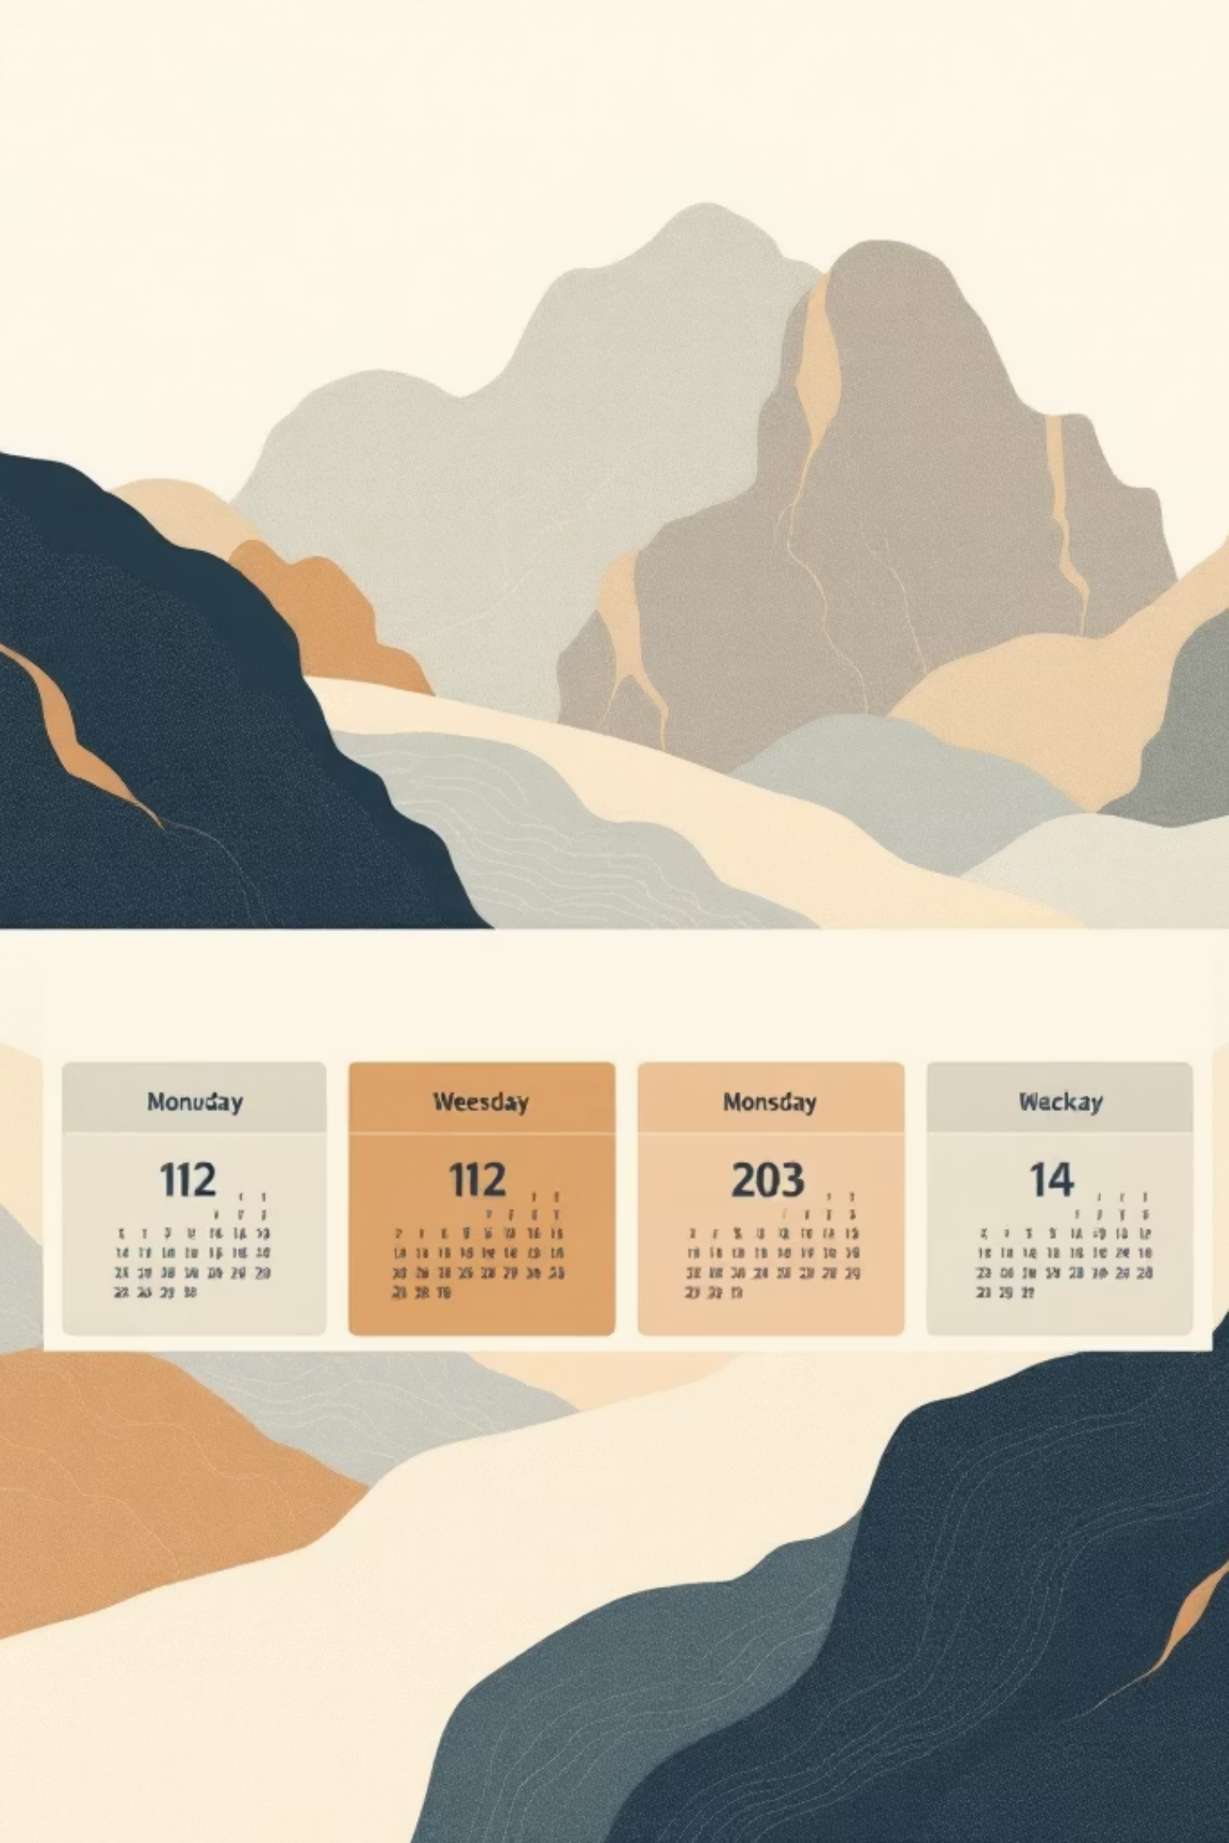
Rotation Engine — How Days Rotate
Week 1
Week 2
Batch 1: Mon–Wed (full day).
Batch 2: Mon–Wed.
Batch 2: Thu–Fri.
Batch 1: Thu–Fri.
Repeat
Engine alternates weekly based on date and repeats indefinitely.
The rotationEngine.js computes the active batch per date; this drives scheduled auto-booking, booking permissions, and UI calendar highlights.

Slide 4




Seat Allocation Rules
Base Seats
50 seats total: 40 allocated to scheduled batch, 10 reserved as buffer.
Scheduled Members
Auto-booked when their batch is scheduled. They may release or rebook up to 2 weeks ahead.
Non-scheduled Members
May book only buffer seats for tomorrow, allowed between 3PM and midnight, subject to buffer availability.

Slide 5

Buffer Quota — Calculation & Flow
Base 10
+ Released Seats
- Non-scheduled
= Available Buffer
Available Buffer = 10 (base) + Released Seats - Non-scheduled Bookings. Releases immediately increment the buffer; non-scheduled booking decrements it. UI updates buffer count in real time.

Slide 6
Booking Rules — Edge Cases
Scheduled Member (on scheduled day)
Non-scheduled Member (off day)
May book or release any date within a 2-week window. If they release, buffer increases (e.g., becomes 11 if one seat released).
Can only book buffer seats for tomorrow, and only after 3PM up to midnight. Booking denied if buffer = 0.
Auto-booked by schedule, editable by user
Can plan two weeks ahead
One-day advance only
Time-gated booking window (>= 3PM)

Slide 7
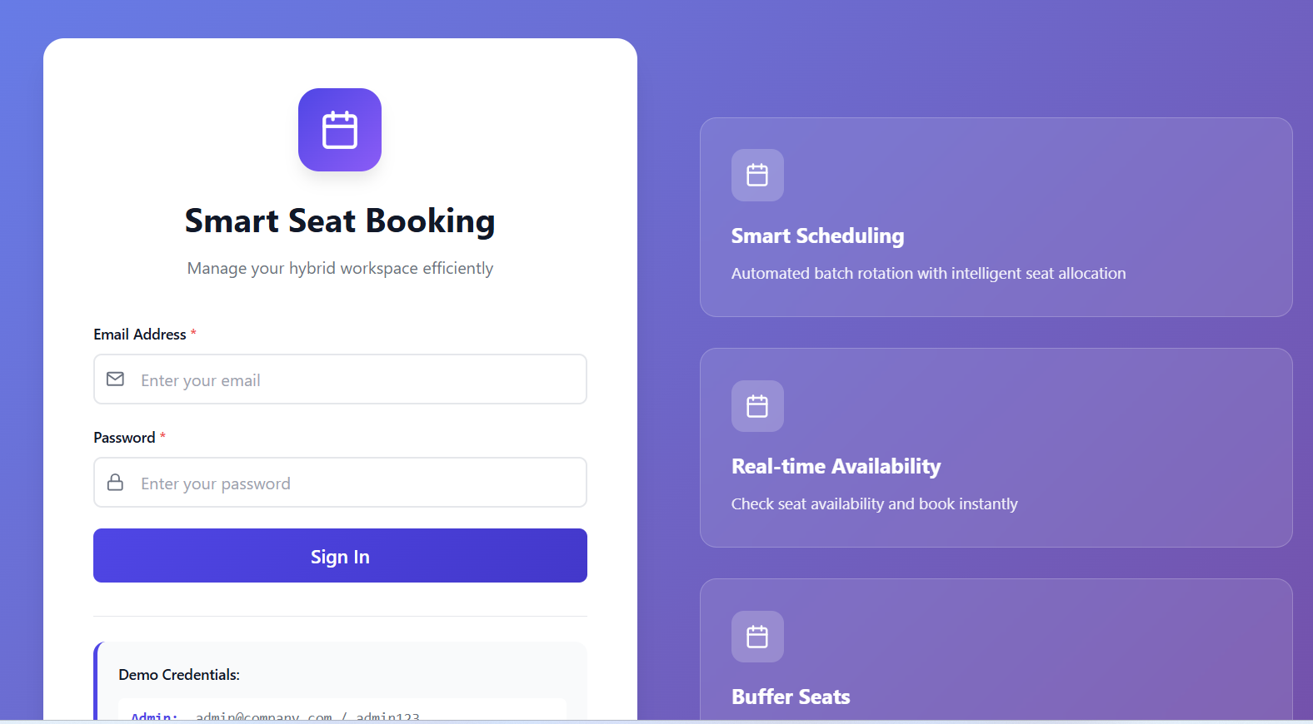
Auth, Roles & Admin Controls
Security
JWT-based sessions with middleware for token validation and role checks (auth.middleware.js).
Roles
Admin — create squads, assign batch, view analytics, adjust buffer if needed
Employee — view schedule, book/release seats within rules
Admin Actions
Bulk import squads, reassign batch membership, export booking logs, and resolve conflicts.

Slide 8
Data Model & Key Endpoints
API (examples)
User
Squad
POST /api/book — create booking (server enforces rules)
DELETE /api/book/:id — release seat (updates buffer)
GET /api/buffer?date= — current buffer count
GET /api/rotation?date= — batch schedule for date
name, email, password, role, squad
name, batch (1/2), members[]
Booking
booking.controller.js handles allocation logic; rotationEngine.js provides authoritative schedule decisions.
user, date, seatNumber, status, isBuffer

Slide 9
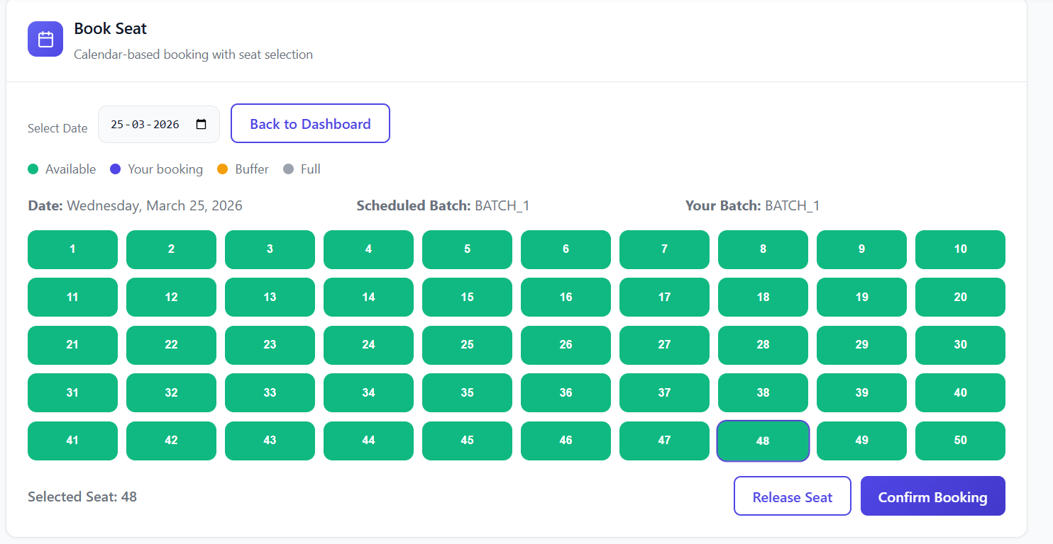
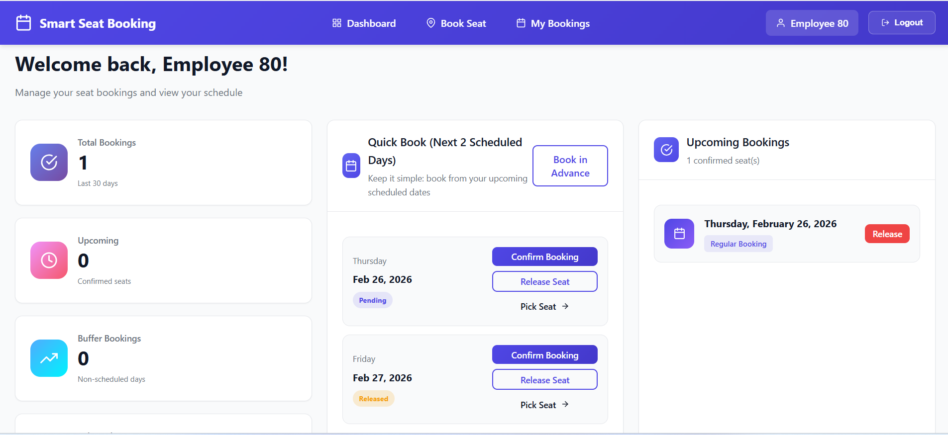
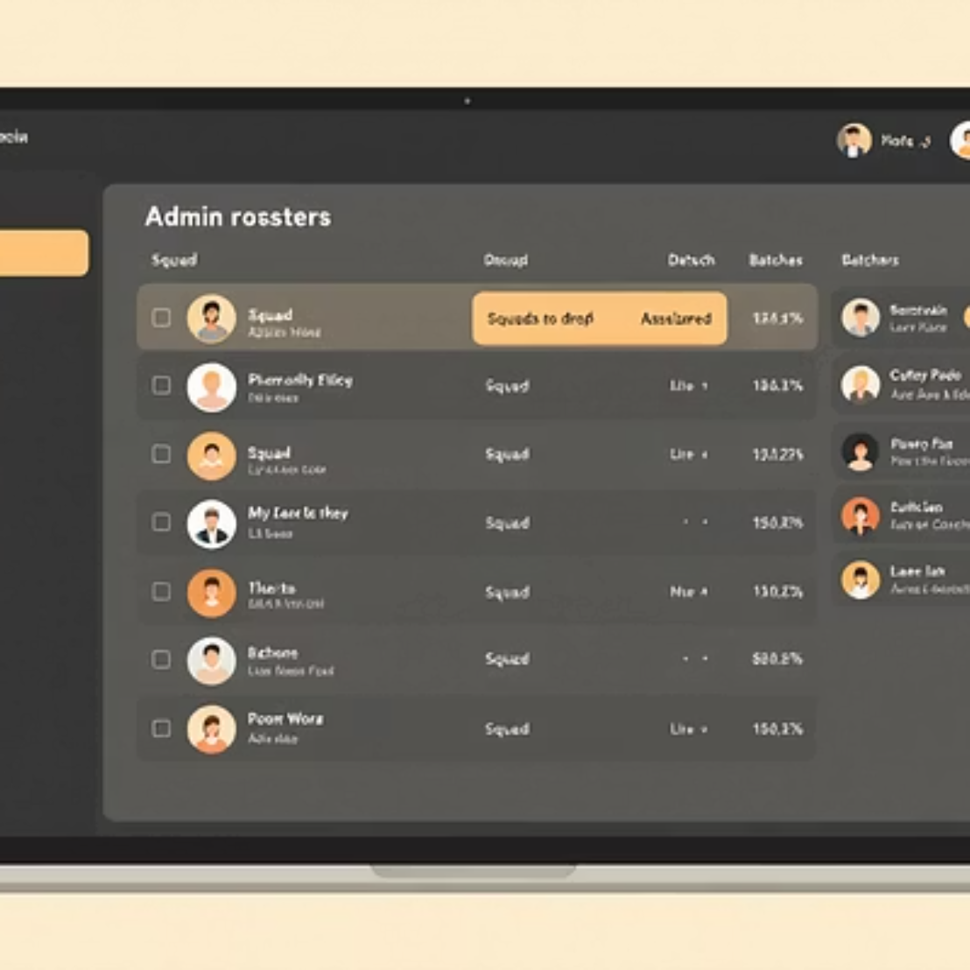
UI / UX — Interactive Experience
Design principles: immediate visibility of buffer, easy one-tap book/release, calendar heatmap for two-week planning, & contextual help explaining time rules.

Slide 10
Thank you

